Slide 1

Penetration Testing Report
nahamstore.thm
Web Application Security Assessment

Slide 2

Executive Summary
Purpose
Key Findings
Comprehensive security assessment of nahamstore.thm web application to identify vulnerabilities and security weaknesses.
18 vulnerabilities discovered across multiple categories, including critical RCE and privilege escalation vectors.
Risk Posture
High-risk environment requiring immediate remediation of critical vulnerabilities to prevent unauthorised access.

Slide 3
Scope of Work
In-Scope
Out-of-Scope
Details
Web application endpoints, forms, APIs, authentication mechanisms
Physical infrastructure, social engineering, DoS attacks
Timeframe: 5 daysRestrictions: Non-destructive testing only

Slide 4







Methodology
Reconnaissance
Information gathering and target profiling
Enumeration
Service and endpoint discovery
Scanning
Vulnerability identification
Discovery
Weakness analysis
Exploitation
Proof of concept
Privilege Escalation
Access elevation
Reporting
Documentation

Slide 5









Tools Used
FFUF
Katana
Fast web fuzzer for content discovery and parameter enumeration.
Next-generation crawling framework for web application mapping.
GoSpider
BurpSuite Pro
Fast web spider for discovering URLs and endpoints.
Comprehensive web application security testing platform.
Arjun
ParamSpider
HTTP parameter discovery tool for finding hidden parameters.
Mining parameters from dark corners of web archives.
Wappalyzer
WhatWeb
Technology profiler identifying CMS, frameworks, and libraries.
Web scanner for identifying technologies and versions.
Wafw00f
Sqlmap
Web application firewall detection and fingerprinting tool.
Automated SQL injection and database takeover tool.
Metasploit 6
Msfvenom
Penetration testing framework for exploit development.
Payload generator for creating custom exploit payloads.

Slide 6
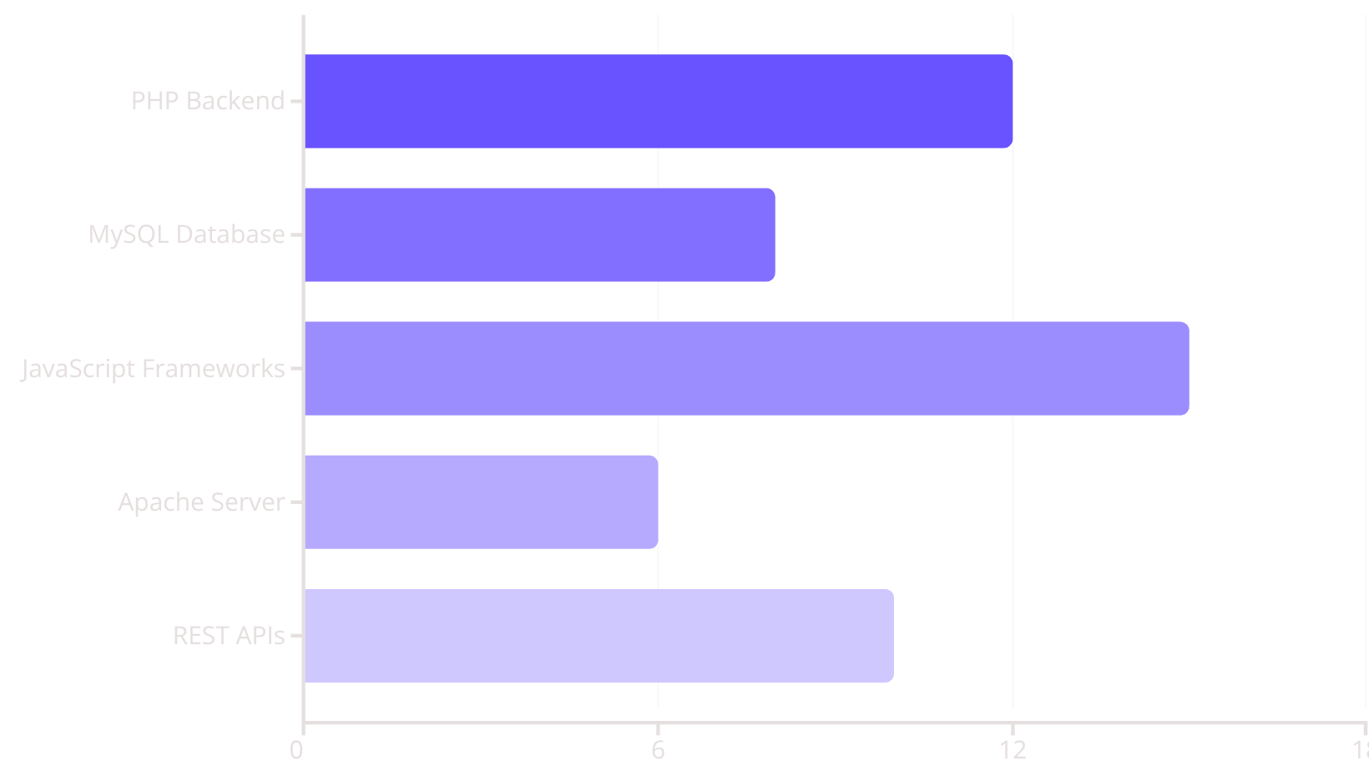
Reconnaissance Results
Technologies Discovered
Attack Surface
47 unique endpoints discovered
23 input parameters identified
8 authentication mechanisms
12 file upload functionalities
5 API endpoints exposed

Slide 7
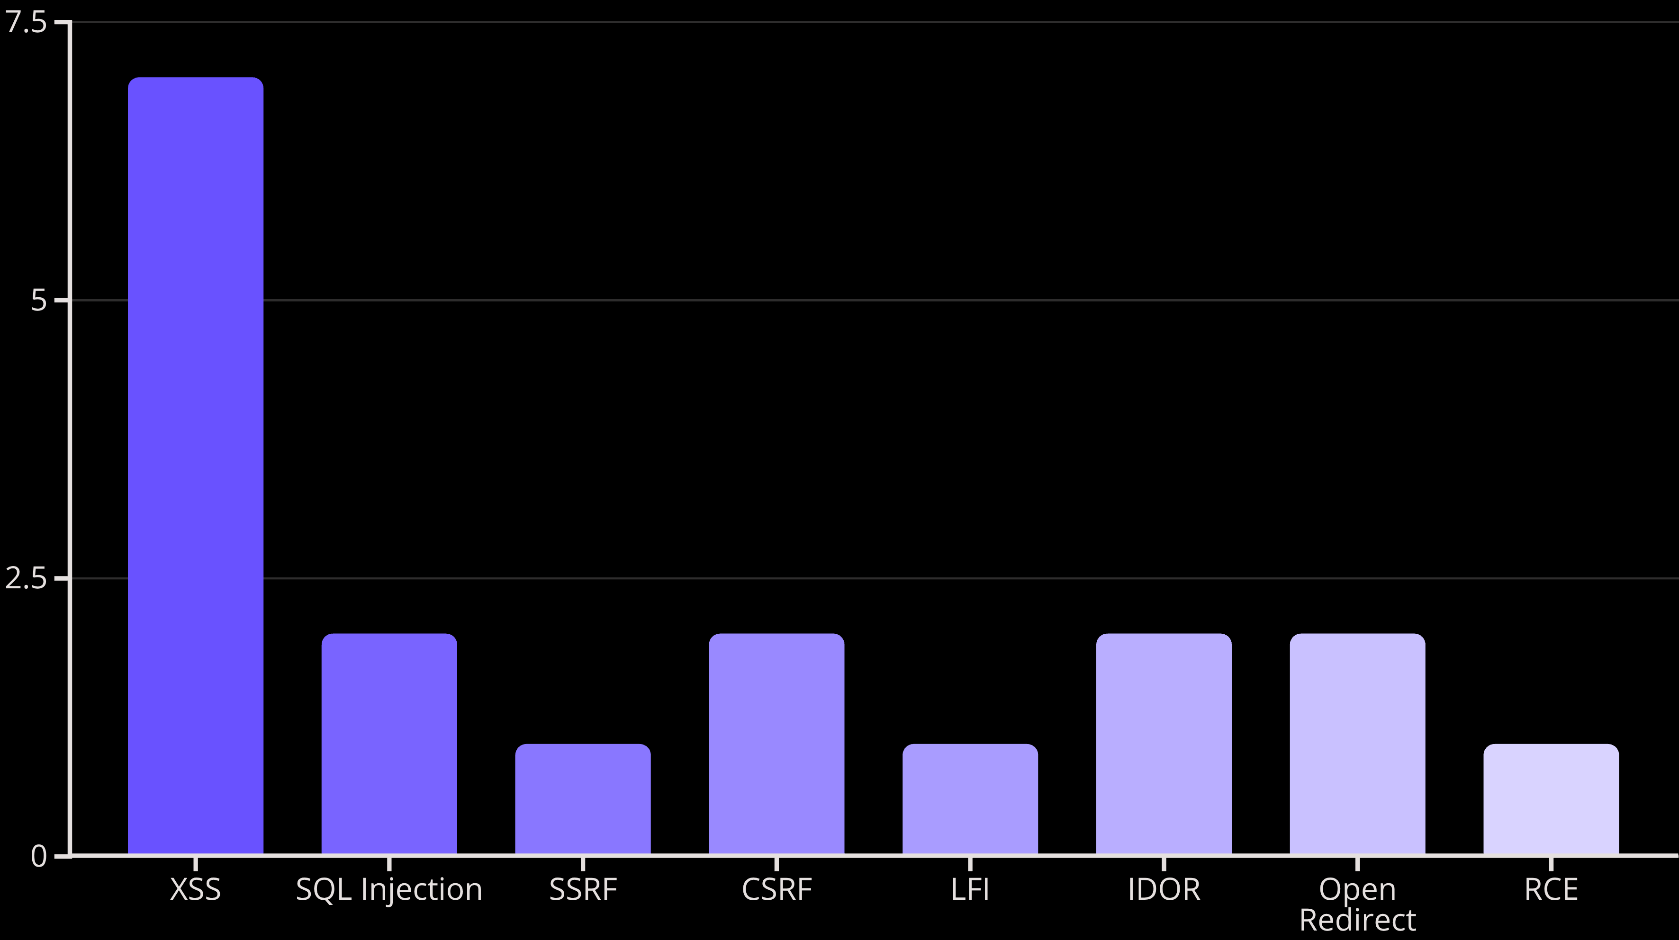
Vulnerability Summary
Total: 18 vulnerabilities discovered, plus 1 privilege escalation vector (CVE-2021-4034).

Slide 8
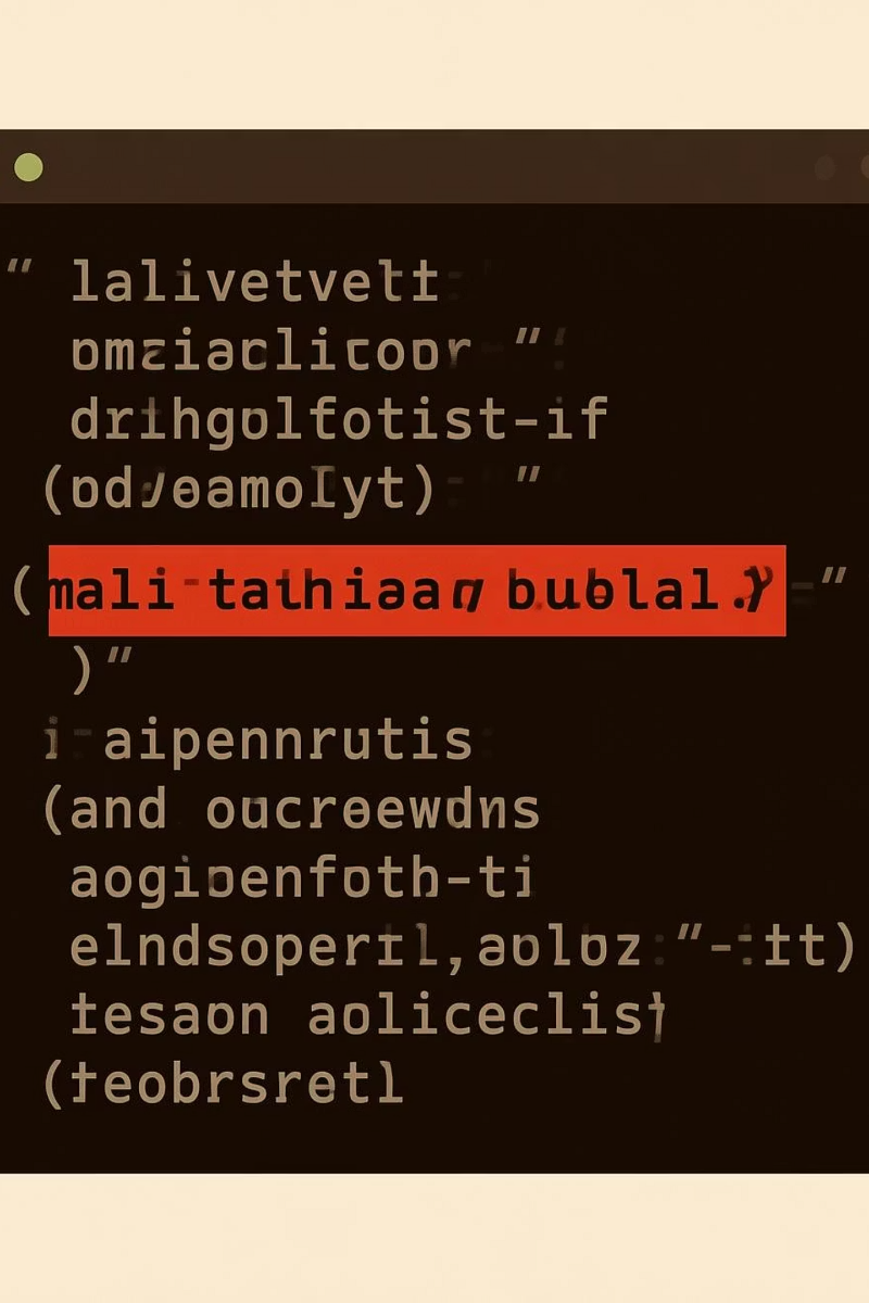
Critical Findings: XSS & SQLi
Cross-Site Scripting (XSS)
Count: 7 instances
Discovery: Found using BurpSuite Pro and manual parameter fuzzing with FFUF.
Impact: Session hijacking, credential theft, malicious script injection affecting user accounts.
Risk Level: High
Sample Payload: <script>alert(document.cookie)</script>
SQL Injection (SQLi)
Count: 2 instances
Discovery: Identified using Sqlmap automated scanning on login and search parameters.
Impact: Complete database compromise, data exfiltration, authentication bypass, potential data manipulation.
Risk Level: Critical
Sample Payload: ' OR '1'='1' --

Slide 9
Attack Path Timeline
Reconnaissance
1
Technology profiling with Wappalyzer and WhatWeb
2
Enumeration
Endpoint discovery using Katana and GoSpider
Fuzzing
3
Content and directory fuzzing with FFUF
4
Parameter Discovery
Hidden parameters found via Arjun and ParamSpider
Exploitation
5
SQLi and XSS exploitation through BurpSuite
6
Shell Access
Reverse shell obtained via RCE vulnerability
RCE
7
Remote code execution achieved using Msfvenom payload
8
Privilege Escalation
Root access via CVE-2021-4034 Polkit exploit

Slide 10

Recommendations & Conclusion
Critical Remediations
Security Posture
XSS: Implement input sanitisation and output encoding
18
3
SQLi: Use prepared statements and parameterised queries
SSRF: Whitelist outbound connections and validate URLs
CSRF: Implement anti-CSRF tokens on all forms
Vulnerabilities
Critical
LFI: Strict path validation and input filtering
Total security issues identified
Requiring immediate attention
IDOR: Enforce proper access control checks
RCE: Disable dangerous functions and validate uploads
8
Polkit: Patch CVE-2021-4034 immediately
High Risk
Significant security impact
Final Assessment: The application requires comprehensive security hardening before production deployment. Immediate patching of critical vulnerabilities is essential.

